Slide 1
Chapter Eight
SEEING OUR FUTURES THROUGH SELF-EFFICACY, OPTIMISM, AND HOPE
Positive Psychology: The Scientific and Practical Explorations of Human Strengths © 2014 SAGE

Slide 2
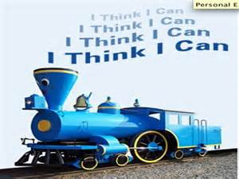
Self-Efficacy
Albert Bandura, Stanford
- Belief that you can accomplish goals
- Based on a sense of personal control
        The belief that one has the means to obtain desired outcomes and to avoid undesirable ones
        Posited that personal control is an innate need
Positive Psychology: The Scientific and Practical Explorations of Human Strengths © 2014 SAGE

Slide 3
Self-Efficacy
Defined as:
- “people’s beliefs in their capabilities to produce desired effects by their own actions” – Bandura
- “what I believe I can do with my skills under certain conditions” - Maddux
Positive Psychology: The Scientific and Practical Explorations of Human Strengths © 2014 SAGE

Slide 4
Self-Efficacy
Includes:
  - Outcome expectancies
        An examination of what needs to be done to reach a desired goal
  - Efficacy expectancies
        The result of an analysis of capability to complete the necessary actions
Positive Psychology: The Scientific and Practical Explorations of Human Strengths © 2014 SAGE

Slide 5
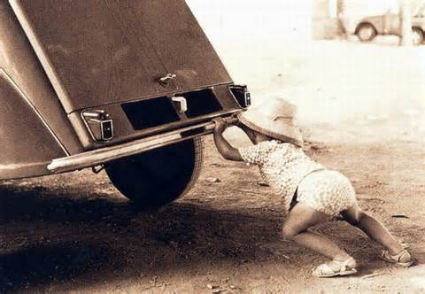
Self-Efficacy
A learned human pattern of thinking
Begins in infancy & continues through life
Based on Social Cognitive Theory:
- humans actively shape their lives/learn by watching others
Positive Psychology: The Scientific and Practical Explorations of Human Strengths © 2014 SAGE

Slide 6
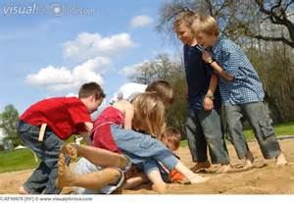
Social Cognitive Theory Foundations
Symbolizing and Vicarious Capabilities: Humans have powerful symbolizing capacities for cognitively creating models of their experiences
  People are affected from direct experience and indirect events
  People can adopt skills and knowledge vicariously
Self-observation & self-regulation
  Evaluate thoughts and actions
  Regulate intentions and behaviors
  Set goals and move towards those goals
Personality is a result of reciprocal interactions
Positive Psychology: The Scientific and Practical Explorations of Human Strengths © 2014 SAGE

Slide 7
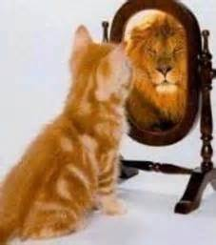
Self-Efficacy
Childhood Antecedents:
1. Previous Similar Successes/Mastery
2. Modeling /Vicarious Learning
3. Imagery/Visualization
4. Verbal Persuasion
5. Arousal & Emotion
Positive Psychology: The Scientific and Practical Explorations of Human Strengths © 2014 SAGE

Slide 8

Self-Efficacy and Cognitive Reframing
Jim Cirillo, NYPD firearms instructor, involved in a number of gunfights
Trained himself with positive imagery to clear his mind of any self-doubting conscious thoughts
“If you jerk the trigger, you will miss the target” became “As you focus on the sights while compressing the trigger smoothly, you will achieve a good shot”
Positive Psychology: The Scientific and Practical Explorations of Human Strengths © 2014 SAGE

Slide 9
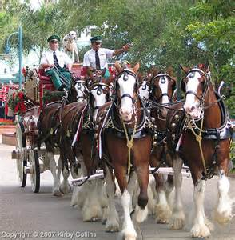
A little encouragement
Cyldesdale Dream Baby
Positive Psychology: The Scientific and Practical Explorations of Human Strengths © 2014 SAGE

Slide 10
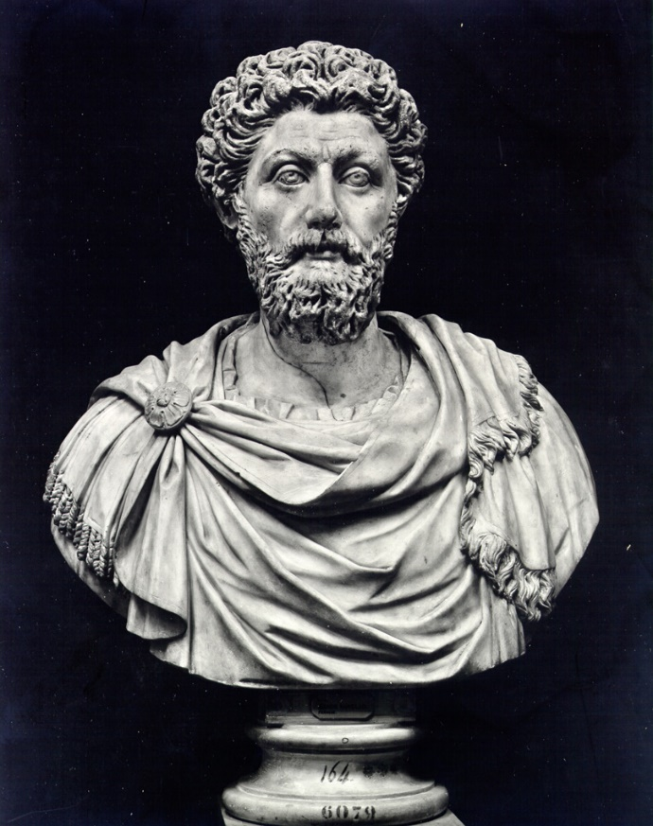
Role Modeling/Vicarious Learning
“Take a good look at people’s ruling principle, especially of the wise, what they run away from and what they seek out.”
– Marcus Aurelius
Positive Psychology: The Scientific and Practical Explorations of Human Strengths © 2014 SAGE

Slide 11

Positive Psychology: The Scientific and Practical Explorations of Human Strengths © 2014 SAGE

Slide 12
Cultural Context and Self – Efficacy
Gender differences in self-efficacy
Women – language arts
Males – math, social sciences, computer sciences
Seems to be due to cultural norms, expectations, and stereotype threat
Masculinity (i.e., a gender role) predicts self-efficacy in technological pursuits regardless of gender
  Men and women with high masculinity had higher SE technology, and men and women with lower masculinity had lower SE technology
Self-efficacy for science
Vicarious learning for females
Mastery experiences for males
Positive Psychology: The Scientific and Practical Explorations of Human Strengths © 2014 SAGE

Slide 13
Culture and Self – Efficacy
American participants expressed higher self- efficacy in abilities even during poor performance
Japanese and Korean students expressed low self- efficacy even with high performance (on difficult math test)
Positive Psychology: The Scientific and Practical Explorations of Human Strengths © 2014 SAGE

Slide 14

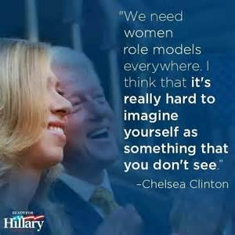
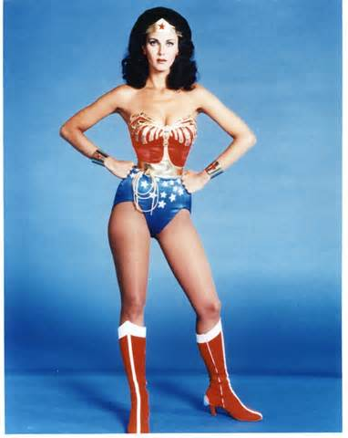
Self-Efficacy and Modeling
Positive Psychology: The Scientific and Practical Explorations of Human Strengths © 2014 SAGE

Slide 15
Measuring Self-Efficacy
Career Self-Efficacy Scale
Occupational Questionnaire
Career Counseling Self-Efficacy Scale
Hurricane Coping Self-Efficacy Scale
Cultural Self-Efficacy Scale
Memory Self-Efficacy Scale
Positive Psychology: The Scientific and Practical Explorations of Human Strengths © 2014 SAGE

Slide 16
Dispositional (Trait) Measures of Self-Efficacy
Cross-situational self-efficacy
Self-Efficacy Scale
  A trait-like index
  23 items
  Factor Analysis: 2 Factors
    General Self-Efficacy
    Social Self-Efficacy
New General Self-Efficacy Scale
Positive Psychology: The Scientific and Practical Explorations of Human Strengths © 2014 SAGE

Slide 17
1 | I can always manage to solve difficult problems if I try hard enough.
2 | If someone opposes me, I can find the means and ways to get what I want.
3 | It is easy for me to stick to my aims and accomplish my goals.
4 | I am confident that I could deal efficiently with unexpected events.
5 | Thanks to my resourcefulness, I know how to handle unforeseen situations.
6 | I can solve most problems if I invest the necessary effort.
7 | I can remain calm when facing difficulties because I can rely on my coping abilities.
8 | When I am confronted with a problem, I can usually find several solutions.
9 | If I am in trouble, I can usually think of a solution.
10 | I can usually handle whatever comes my way.
Response Format | 1 = Not at all true 2 = Hardly true 3 = Moderately true 4 = Exactly true
Positive Psychology: The Scientific and Practical Explorations of Human Strengths © 2014 SAGE

Slide 18
Self-Efficacy
Higher (situational) self-efficacy predicts:
- lower anxiety
- higher pain tolerance
- better academic performance
- more political participation
- effective dental practices
- using smoking cessation treatment
- exercise and diet regimes
Positive Psychology: The Scientific and Practical Explorations of Human Strengths © 2014 SAGE

Slide 19
Self-Efficacy in Psychological Adjustment
High Self-Efficacy related to:
- lower depression
- successful coping
- overcoming eating disorders & abuse
- dealing with schizophrenia
- life satisfaction
Positive Psychology: The Scientific and Practical Explorations of Human Strengths © 2014 SAGE

Slide 20
Self-Efficacy in Physical Health
High Self-Efficacy related to:
- increased health-related behaviors
- decreased unhealthy behaviors
- increased immune functioning
- increased catecholemines
(neurotransmitters implicated in stress management)
- increased pain endorphins
-dealing with multiple sclerosis
Positive Psychology: The Scientific and Practical Explorations of Human Strengths © 2014 SAGE

Slide 21
Self-Efficacy in Psychotherapy
Self-Efficacy as a common factor in therapy
Build self-efficacy in therapy via 5 strategies:
Building successes
Using models
Self imagining
Verbal persuasion
Lowering arousal (e.g., meditation, biofeedback, hypnosis, relaxation)
Positive Psychology: The Scientific and Practical Explorations of Human Strengths © 2014 SAGE

Slide 22
Development of Cultural Competence and Acculturation
Bicultural self-efficacy: sense of assurance in ability to participate and interact in the culture of origin and a second culture
Associated with decrease in acculturative stress
Potential benefits for majority group members to learn about minority cultural groups
Cultural self-efficacy: associated with motivation, cognitive resources, and courses of action necessary in situations characterized by diversity
Positive Psychology: The Scientific and Practical Explorations of Human Strengths © 2014 SAGE

Slide 23
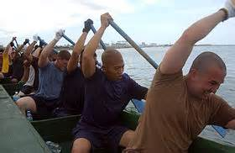
Collective Self-Efficacy
“The extent to which we believe that we can work together effectively to accomplish our goals” - Maddux
No agreement on how to measure
Appears to play a role in classrooms & work teams
Positive Psychology: The Scientific and Practical Explorations of Human Strengths © 2014 SAGE

Slide 24
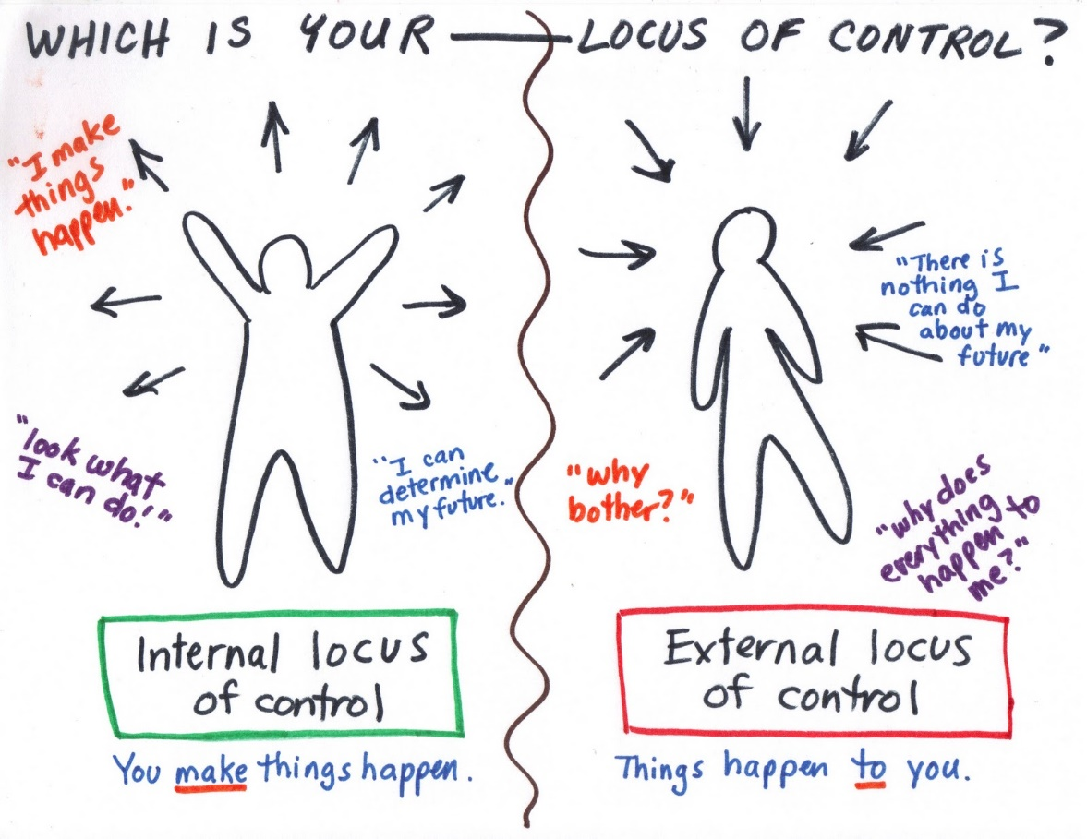
Optimism and Personal Control
Personal Control
  Locus of Control
    The extent to which you feel you have control over events that affect you
Positive Psychology: The Scientific and Practical Explorations of Human Strengths © 2014 SAGE

Slide 25
Core Self-Evaluations
Core Self-Evaluations = one's fundamental appraisal of oneself; a stable personality trait
People who have high core self-evaluations will think positively of themselves and be confident in their own abilities
People who have low core self-evaluations will have a negative appraisal of themselves and will lack confidence
Positive Psychology: The Scientific and Practical Explorations of Human Strengths © 2014 SAGE

Slide 26
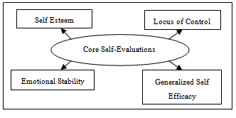
Core Self-Evaluations
4 Dimensions of Core Self-Evaluations
  Locus of Control
  Neuroticism/Emotional Stability
  Generalized Self-Efficacy
  Self-Esteem
Positive Psychology: The Scientific and Practical Explorations of Human Strengths © 2014 SAGE

Slide 27
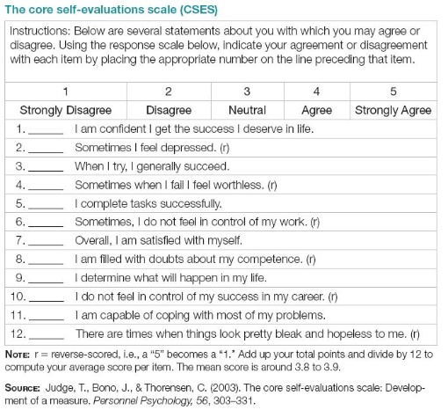
Positive Psychology: The Scientific and Practical Explorations of Human Strengths © 2014 SAGE

Slide 28
Attributions
Attributions: process by which we explain the causes of behavior (ours and others) and events
Fundamental Attribution Error
  Used when looking at cause of other’s behavior
  Tend to overestimate personality and dispositional explanations and underestimate situational explanations
Self-Serving Bias
  Used when looking at causes of our own behavior
  When we succeed, tend to attribute to internal causes, but when we fail, tend to attribute it to situational causes
Positive Psychology: The Scientific and Practical Explorations of Human Strengths © 2014 SAGE

Slide 29
Learned Optimism
Martin Seligman, University of Penn
- Based on learned helplessness and attributional style theories
- Optimists make external, variable, and specific attributions for failure
- Pessimists make internal, stable, and global attributions for failure
Positive Psychology: The Scientific and Practical Explorations of Human Strengths © 2014 SAGE

Slide 30
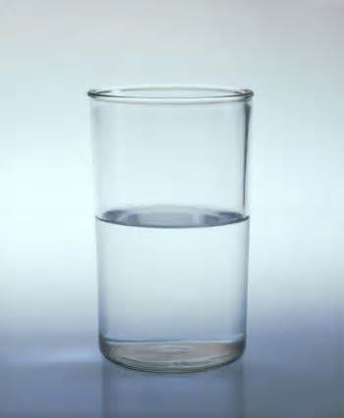
Optimist vs. Pessimist
Positive Psychology: The Scientific and Practical Explorations of Human Strengths © 2014 SAGE

Slide 31
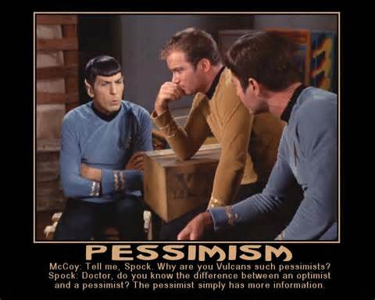
Positive Psychology: The Scientific and Practical Explorations of Human Strengths © 2014 SAGE

Slide 32
What is Optimism?
Commonsense View
  “the glass is half full”
  “see the silver lining…”
  Expecting to see a Hollywood ending to real troubles
  Positive thinking angle: repeat boosterish phrases to ourselves (e.g., “I’m getting better and better” or visualize success)
  These are all manifestations of optimism…optimism is deeper
What is fundamental to optimism lies in the way we think about causes, our explanatory style
Explanatory style develops in childhood, and without explicit intervention, is lifelong
Seligman, The Optimistic Child

Slide 33
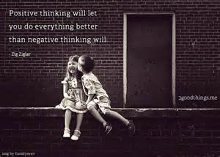
3 Dimensions of Explanatory Style
Permanence
Pervasiveness
Personalization
Seligman, The Optimistic Child

Slide 34
1) Permanence
Permanence: Sometimes vs. Always
Kids who believe that causes of bad events are permanent are more at risk for depression…if the cause will persist, then bad events are always going to recur
Project effects of causes across time
Seligman, The Optimistic Child

Slide 35
1) Permanence (bad events)
Permanent (Pessimistic)
“No one will every want to be friends with me at school.”
“My mom is the crabbiest mom in the entire world.”
“Tony hates me and will never hang out with me again.”
Temporary (Optimistic)
“It takes time to find a new best friend when you move to a new school.”
“My mom is in the crabbiest mood ever.”
“Tony is mad at me today and won’t hang out with me.”
Seligman, The Optimistic Child

Slide 36
1) Permanence (good events)
Temporary (Pessimistic)
“The only reason I won the spelling bee is because I practiced hard this time.”
I was voted captain of the safety patrol because the other kids wanted to do a nice thing for me.”
Dad has been spending his time with me because he has been in a good mood lately.”
Permanent (Optimistic)
“I won because I am a hard worker and I study my lessons.”
“I was voted captain of the safety patrol because the other kids like me.”
“Dad loves to spend time with me because he enjoys my company.”
Seligman, The Optimistic Child

Slide 37
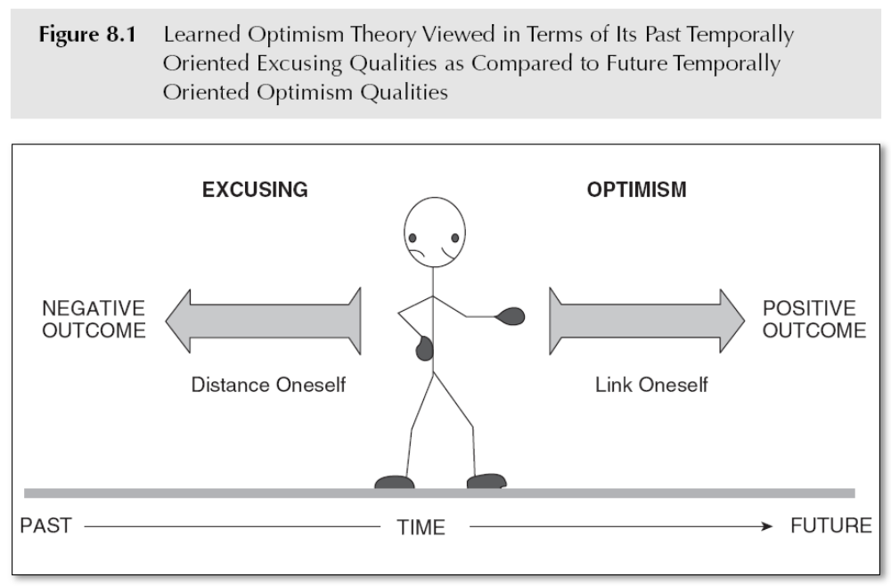
Learned Optimism
Positive Psychology: The Scientific and Practical Explorations of Human Strengths © 2014 SAGE
Notes:
Check correct

Slide 38
2) Pervasiveness
Pervasiveness: Specific vs. Global
If you believe a cause is pervasive, you project its effect across different situations in your life
Same event: strikes out at baseball game
  Child one: “I stink at baseball” and goes home and goes to room. Doesn’t eat much at dinner. Won’t talk about it. Thinks he sticks at baseball and everything else. Withdrawal lasts for days
  Child two: “I stink at baseball.” Upset at home but talks to mom about the game. Tells dad at dinner what happened. Thinks the pitcher was exceptional and that’s why struck out. Makes plans with friends for the next day.
Seligman, The Optimistic Child

Slide 39
2) Pervasiveness
  Both permanent (not good baseball players)
  Child One was catastrophizer
  Child Two found local causes
  Children who latch onto global explanations for their failures give up on everything when they fail in just one realm
  Children who believe specific explanations may become helpless in that one realm yet march confidently onto the next
Seligman, The Optimistic Child

Slide 40
2) Pervasiveness: Bad Events
Global (Pessimistic)
“Teachers are unfair.”
“I’m a total clod at sports.”
“Nobody likes me.”
Specific (Optimistic)
“Mrs. Carmine is unfair.”
“I stink at kickball.”
“Jamal doesn’t like me.”
Seligman, The Optimistic Child

Slide 41
2) Pervasiveness: Good Events
Specific (Pessimistic)
“I’m smart at math.”
“Erica invited me to her party because she likes me.”
“I got to play Oliver because I’m a good singer.”
Global (Optimistic)
“I’m smart”
“Erica invited me to her party because I’m popular.”
“I got to play Oliver because I’ve got a lot of talent.”
Seligman, The Optimistic Child

Slide 42
3) Personal
Personal: Internal vs. External
Deciding who is at fault (self or others/circumstances)
Self-esteem is governed by who you blame
  Blame self when fail..often have low self-esteem, guilt and shame
  Blame others/circumstances…often feel better about self, less guilt and shame and life self better, but also angrier
So, should we teach children to be external (blame) when they experience bad events?
Seligman, The Optimistic Child

Slide 43
3) Personal
NO
Children must be held accountable when they are to blame for things they have done, and then should try to rectify the situation
BUT, don’t want a generation of children who blame themselves whenever things go wrong whether it was their fault or not
Positive Psychology: The Scientific and Practical Explorations of Human Strengths © 2014 SAGE

Slide 44
3) Personal
Goal: teach children how to see themselves accurately, so that when problems are their fault, they take responsibility and try to correct their behavior, whereas when the problem is not their fault, they still feel worthwhile
Seligman, The Optimistic Child

Slide 45
General vs. Behavioral Self-Blame
General (Pessimistic-permanent, pervasive, internal)
“I got a C on the test because I am stupid.”
“I got picked last in gym class again. No one likes me.”
I got grounded because I’m a bad kid.”
Behavioral (Optimistic-temporary, specific, internal)
“I got a C on the test because I didn’t study hard enough.”
I got picked last in gym class again. I’m no good at soccer!”
I got grounded because I hit Michelle.”
Positive Psychology: The Scientific and Practical Explorations of Human Strengths © 2014 SAGE

Slide 46
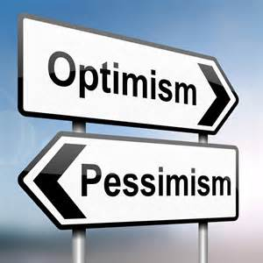
Childhood Antecedents of Learned Optimism
Partly genetic
  Monozygotic twins r = .48
  Dizygotic twins r = .00
Partly learned
  Parents provided safe, coherent environments
  Parents modeled optimism
    Made explanations for negative events
    Provided explanations for positive events
    Had parents who understood failures and attributed them to external causes (adaptive excusing)
Positive Psychology: The Scientific and Practical Explorations of Human Strengths © 2014 SAGE

Slide 47
The Right Way to Criticize
Be accurate with blame when criticizing self (because of modeling) and child
  “You are so lazy” makes child believe he is lazy and it is permanent and unchangeable
When appropriate, criticize with an optimistic explanatory style
  When child is at fault, focus on specific and temporary personal causes, and avoid blaming the child’s character or ability
Positive Psychology: The Scientific and Practical Explorations of Human Strengths © 2014 SAGE

Slide 48
Criticizing a Preschool Child
Permanent (Pessimistic)
“Tammy, what’s wrong with you? You are always such a monster!”
“Wendy said you cried the whole time I was out. You’re such a sensitive child.”
“Cory, I asked you to pick up your toys. Why don’t you ever do what I ask?”
Changeable (Optimistic)
“Tammy, you are really misbehaving today. I don’t like it at all.”
“Wendy said you cried the whole time I was out. You’ve been having a hard time being away from me lately.”
“Cory, I asked you to pick up your toys. Why didn’t you do what I asked?”
Seligman, The Optimistic Child

Slide 49
Criticizing a Preschool Child
Global (Pessimistic)
“You are a bad boy.”
“That’s OK Tanya. You’ve got your mom’s knack when it comes to sports. I’m horrible at sports too.”
“She never likes to play with the other kids. She’s so shy.”
Specific (Optimistic)
“You tease your sister too much.”
That’s OK Tanya. You’ve got to learn to keep your eye on the ball.
“She has a hard time joining groups of kids.”
Seligman, The Optimistic Child

Slide 50
Criticizing a Preschool Child
Internal and General (Passive)
“You’re not athletic.”
“You kids are so selfish.”
“Another C-?! I guess you just aren’t an A student.”
“This room is a pig sty! You are such a slob!”
Internal and Behavioral (Active)
“You have to work harder on watching the ball meet the bat.”
“You kids must share more.”
“Another C-?! You need to spend more time on your studies.”
“This room is a pig sty! You need to start picking up after yourself.”
Seligman, The Optimistic Child

Slide 51
Increasing Optimism
If someone falsely accuses us, we dispute with them, but when we have pessimistic thoughts, rarely do we dispute them.
First thing: recognize pessimistic thought
Second: dispute with ABCDE model
Positive Psychology: The Scientific and Practical Explorations of Human Strengths © 2014 SAGE

Slide 52
ABCDE Model for Pessimistic Thoughts
A Adversity
B Beliefs
C Usual consequences
D Disputation of your routine belief
E Energization that occurs when dispute successfully
Authentic Happiness (Seligman)

Slide 53
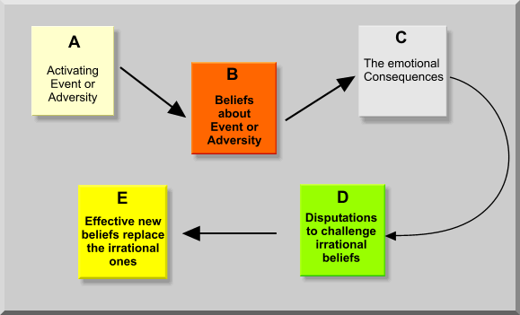
ABCDE Model
Positive Psychology: The Scientific and Practical Explorations of Human Strengths © 2014 SAGE

Slide 54
Disputations
Disputations involve checking out the accuracy of the beliefs about ourselves that are encouraging us to feel pessimistic
Positive Psychology: The Scientific and Practical Explorations of Human Strengths © 2014 SAGE

Slide 55
4 ways to make disputations convincing
Evidence
  Show negative belief is factually incorrect
  Most negative beliefs are overreactions
  E.g., “worst in class”…ask other students about their grade
Alternatives
  Ask yourself if there are alternative ways to look at the problem which are less damaging to yourself, and focus on causes that are changeable
  Scan for all possible contributing causes (pessimists latch on to worst of all these causes, usually permanent and pervasive one)
  Focus on causes that are changeable, specific, and nonpersonal

Slide 56
4 ways to make disputations convincing
3) Implications
  Negative belief may be true…so, decatastrophize.
  E.g., I’m factual and straightforward. What’s the implication? Doesn’t mean I won’t have any friends.
4) Usefulness:
  Is belief destructive? How can you change situation in future?

Slide 57
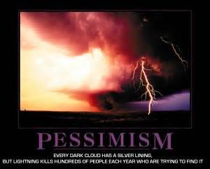
Pessimism
Modeled by parents
Link to television viewing
Related to parental death or divorce, abuse, incest
Positive Psychology: The Scientific and Practical Explorations of Human Strengths © 2014 SAGE

Slide 58
Measures of Learned Optimism
Attributional Style Questionnaire (ASQ)
Children’s Attributional Style Questionnaire (CASQ)
Content Analysis of Verbal Explanation approach (CAVE)
Positive Psychology: The Scientific and Practical Explorations of Human Strengths © 2014 SAGE

Slide 59
Learned Optimism
Learned optimism associated with:
- better academic performances
- superior athletic performances
- work productivity
- relationship satisfaction
- effective coping
- less vulnerability to depression
- superior physical health
Positive Psychology: The Scientific and Practical Explorations of Human Strengths © 2014 SAGE

Slide 60
Dispositional Optimism: Scheier and Carver
Michael Scheier & Charles Carver
- Stable tendency to believe that good rather than bad things will happen
- When we have a goal that is important to us, we produce an expectancy about attainment of that goal
- Do not emphasize personal efficacy
Positive Psychology: The Scientific and Practical Explorations of Human Strengths © 2014 SAGE

Slide 61
Optimism: Scheier and Carver
View optimism in the context of self-regulated actions aimed at the achievement of personal goals
Expectations and confidence become important when we face challenges and obstacles to goal attainment
Optimists believe they can overcome challenges and persevere in their efforts
Pessimists have less confidence and positive expectations and are likely to become passive or give up their efforts
Positive Psychology: The Scientific and Practical Explorations of Human Strengths © 2014 SAGE

Slide 62
Dispositional Optimism Research
Coping with distress
  Optimism consistently linked to lower levels of personal distress, pessimism to higher levels of distress
Coping with life transitions
  Having 1st child
    Optimism may offer resistance to post-partum depression
  Coronary bypass surgery
    Optimists reported less presurgical distress, more confidence in and satisfaction with their medical care, more relief and happiness shortly after surgery, and greater post-surgery lift satisfaction
  HS to College
Positive Psychology: The Scientific and Practical Explorations of Human Strengths © 2014 SAGE

Slide 63
Coping with HS to College Transition
Aspinwall and Taylor (1992) examined 3 individual differences as predictors of successful adaptation
Self-esteem, perceived control, and optimism
At beginning of second semester, college students completed 4 measures related to college adjustment, responding to items addressing their levels of stress, their happiness, and their general well-being
Optimism had a direct and independent positive effect
Continued…
Positive Psychology: The Scientific and Practical Explorations of Human Strengths © 2014 SAGE

Slide 64
Coping with HS to College Transition
Perceived control and self-esteem were more indirect and depended on their relation to active rather than avoidant coping with college success
  High self-esteem and personal control improved adjustment only if students also actively sought solutions and help for adjustment problems
  If they avoided rather than confronted their problems, the benefits of self-esteem and presonal control were diminished
Positive Psychology: The Scientific and Practical Explorations of Human Strengths © 2014 SAGE

Slide 65
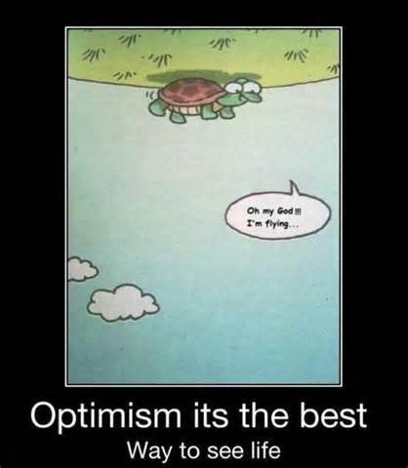
Childhood Antecedents of Optimism
Genetic basis
Learning component from early childhood experiences with parental figures (trust and secure attachment)
Positive Psychology: The Scientific and Practical Explorations of Human Strengths © 2014 SAGE

Slide 66

College Students…Why are you optimistic?
Feelings that the world was just
Personal privileges and benefits in life
Feelings of hope
Belief in a higher power
Positive Psychology: The Scientific and Practical Explorations of Human Strengths © 2014 SAGE

Slide 67
Optimism Measures
Life Orientation Test (LOT)
Life Orientation Test – Revised (LOT-R)
Positive Psychology: The Scientific and Practical Explorations of Human Strengths © 2014 SAGE

Slide 68
Life Orientation Test
0= strongly disagree to 4=strongly agree
In uncertain times, I usually expect the best.
If something can go wrong for me, it will.
I’m always optimistic about the future.
I hardly ever expect things to go my way.
I rarely count on good things happening to me.
Overall, I expect more good things to happened to me than bad.
Positive Psychology: The Scientific and Practical Explorations of Human Strengths © 2014 SAGE

Slide 69
Optimism
Optimism related to:
  Problem-solving
  Planfulness
  Approach-oriented coping (reframe and see the best in situations)
  Positive reframing
  Going to college
  Good work performance
  Coping with cancer
  Seeing daily stresses in terms of potential growth and tension reduction
Positive Psychology: The Scientific and Practical Explorations of Human Strengths © 2014 SAGE

Slide 70
Optimism
Optimists know when to give up versus when to keep on plugging
Pessimists still pursue a goal when it is not the smart thing to do
Positive Psychology: The Scientific and Practical Explorations of Human Strengths © 2014 SAGE

Slide 71
How Optimism Works
Optimism is a source of motivation
  Easier to initiate action when we believe our actions will lead to positive outcomes
    Challenging situations: optimism energizes continued action, while pessimism may lead to giving up
Optimism is connected to more effective coping
  Better at dealing with stress
  More likely to use active coping strategies aimed at confronting and solving problems
Positive Psychology: The Scientific and Practical Explorations of Human Strengths © 2014 SAGE

Slide 72
How Optimism Works
Optimists are more flexible in the use of different coping approaches
  Optimists distinguish between controllable and uncontrollable life stressors and adjust their coping strategies appropriately
Positive Psychology: The Scientific and Practical Explorations of Human Strengths © 2014 SAGE

Slide 73
Coping Strategies
Optimists
Information seeking
Active coping and planning
Positive reframing
Seeking benefit
Use of humor
Acceptance
Pessimists
Suppression of thoughts
Giving up
Self-distraction
Cognitive avoidance
Focus on distress
Overt denial
Positive Psychology: The Scientific and Practical Explorations of Human Strengths © 2014 SAGE

Slide 74

Hope
C. R. Snyder, Hope Theory
  Emphasizes cognitions built on goal-directed thought
  Combines elements of expectation and agency in defining hope as willpower and “waypower”
Positive Psychology: The Scientific and Practical Explorations of Human Strengths © 2014 SAGE

Slide 75
Snyder Hope Theory
Agency: the willpower that provides the energy and determination to persist in the pursuit of personally important goals
Pathways thinking: is the “waypower,” or confidence that routes to desired goals can be identified and, when obstacles are encountered, alternative routes can be found
Positive Psychology: The Scientific and Practical Explorations of Human Strengths © 2014 SAGE

Slide 76
Hope Scale examples
I energetically pursue my goals (agency)
My past experiences have prepared me well for the future (agency)
I can think of many ways to get out of a jam (pathways)
Even when others get discouraged, I know I can find a way to solve the problem (pathways)
Positive Psychology: The Scientific and Practical Explorations of Human Strengths © 2014 SAGE

Slide 77
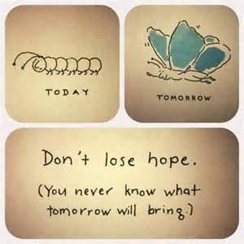
Hope
Hope theory =
  Goals must be important to the person
  Goals can vary temporally (short, long-term)
  Goals may be approach oriented (to reach a goal)
  Goals may be preventative (to stop an undesired event)
  Goals can vary in degrees of difficulty of attainment
Positive Psychology: The Scientific and Practical Explorations of Human Strengths © 2014 SAGE

Slide 78
Hope
People with high levels of hope
  See barriers as challenges
  Explore alternate routes
  Apply motivations to those routes
Positive Psychology: The Scientific and Practical Explorations of Human Strengths © 2014 SAGE

Slide 79
Childhood Antecedents of Hope
No hereditary component
Entirely learned
Inherent part of parenting; strong attachment is crucial for high hope
Components in place by age 2
Childhood traumas lesson hope
Positive Psychology: The Scientific and Practical Explorations of Human Strengths © 2014 SAGE

Slide 80
Measures of Hope
Adult Trait Hope Scale
Adult State Hope Scale
Children’s Hope Scale
Domain specific hope scales:
Academic Hope Scale
Math Hope Scale
Positive Psychology: The Scientific and Practical Explorations of Human Strengths © 2014 SAGE

Slide 81
Adult Hope Scale
1 = Definitely False, 2 = Mostly 3 = Somewhat 4 = Slightly 5 = Slightly True 6 = Somewhat 7 = Mostly 8 = Definitely True
___ 1. I can think of many ways to get out of a jam.
___ 2. I energetically pursue my goals.
___ 3. I feel tired most of the time.
___ 4. There are lots of ways around any problem.
___ 5. I am easily downed in an argument.
___ 6. I can think of many ways to get the things in life that are important to me.
___ 7. I worry about my health.
___ 8. Even when others get discouraged, I know I can find a way to solve the problem.
___ 9. My past experiences have prepared me well for my future.
___10. I’ve been pretty successful in life.
___11. I usually find myself worrying about something.
___12. I meet the goals that I set for myself.
Positive Psychology: The Scientific and Practical Explorations of Human Strengths © 2014 SAGE

Slide 82
Adult Hope Scale Scoring
Scoring:
Items 2, 9, 10, and 12 make up the agency subscale.
Items 1, 4, 6, and 8 make up the pathway subscale.
Researchers can either examine results at the subscale level or combine the two subscales to create a total hope score.
Positive Psychology: The Scientific and Practical Explorations of Human Strengths © 2014 SAGE

Slide 83
Hope
Hope predicts:
- academic performance (GPA)
- sport performance
- physical health
- adjustment
- psychotherapy outcomes
Positive Psychology: The Scientific and Practical Explorations of Human Strengths © 2014 SAGE

Slide 84
Hope and Optimism
Hopeful people tend to be optimistic, and hope adds the importance of flexible thinking, problem-solving ability, and self-motivation to an understanding of the coping benefits of optimism
  Hopeful are:
    More skilled in generating alternative means for achieving goals when they encounter roadblocks to original plans
    Better problem solvers
    More likely to use positive “self-talk” such as “I can do this”
    Focus on what needs to be done rather than ruminating about what went wrong
Positive Psychology: The Scientific and Practical Explorations of Human Strengths © 2014 SAGE

Slide 85
Collective Hope
The level of goal-directed thinking of a large group of people
Often seen when a goal cannot be achieved by a single person
Positive Psychology: The Scientific and Practical Explorations of Human Strengths © 2014 SAGE

Slide 86
Appendix A:A Summary of Hope Theories
Averill – defines hope in cognitive terms relative to goals
Breznitz – uses metaphors to capture the operation of hope in response to stressors
Erickson – use hope from a lifespan perspective, particularly regarding the stage of generativity versus stagnation.
Gottschalk – discusses positive expectancies about outcomes
Positive Psychology: The Scientific and Practical Explorations of Human Strengths © 2014 SAGE

Slide 87
Appendix A: A Summary of Hope Theories
Marcel – assumes hope gives people the power to cope with helpless circumstances
Mowrer – discusses pleasurable aspects of hope, and the antithesis of hope: fear
Staats – use hope as the interaction between wishes and expectations, consisting of affective and cognitive aspects
Stotland – explore the role of expectancies and cognitive schemas; hope as a goal
Positive Psychology: The Scientific and Practical Explorations of Human Strengths © 2014 SAGE

Slide 88
Mini-Experiments
Balancing Your Perspective on Time
  Reflecting on our day to produce an estimate of time spent “in the past,” “in the present,” and “in the future.” See page 214 for table to use
  In the last minute of each hour, estimate the number of minutes you spent in that previous hour thinking about past, present or future.
Positive Psychology: The Scientific and Practical Explorations of Human Strengths © 2014 SAGE

